Slide 1
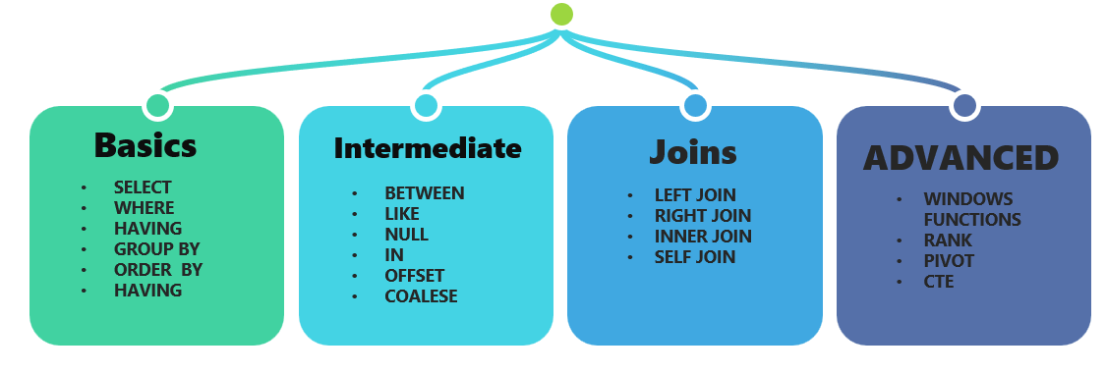
Module 4
Chapter 1: SQL: Advanced Queries
By: Md. Tahir Mirji

Slide 2
Comparisons Involving NULL and Three-Valued Logic
SQL has various rules for dealing with NULL values. NULL is used to represent a missing value, but that it usually has one of three different interpretations value
Example
1. Unknown value: A person’s date of birth is not known so it is represented by NULL in the database.
2. Unavailable or withheld value : A person has a home phone but does not want it to be listed, so it is withheld and represented as NULL in the database.
3. Not applicable attribute :An attribute CollegeDegree would be NULL for a person who has no college degrees because it does not apply to that person.

Slide 3
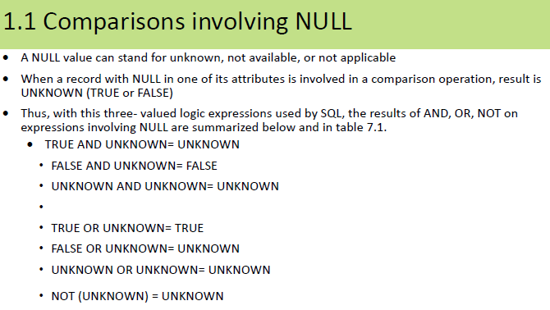

Slide 4
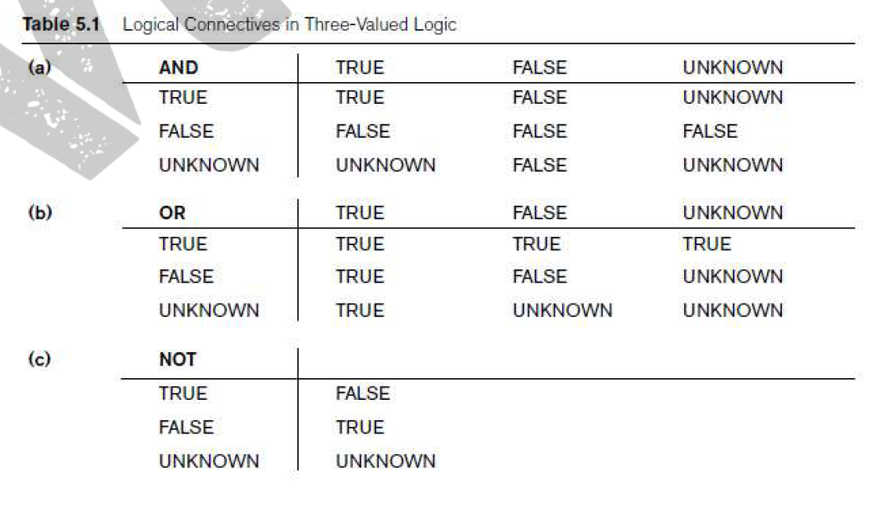
In three-valued logic, logical connectives like "and", "or", "not" are used to handle the "unknown" or "null" value, in addition to true and false, when evaluating conditions or expressions.
This is particularly important in SQL, where NULL represents a missing or unknown value, and comparisons involving NULLs can result in an "unknown" outcome.

Slide 5
How Connectives Work with NULL in Three-Valued Logic
AND: If one operand in an AND operation is NULL, the result is NULL (unknown). This is because the result depends on the unknown value.
Example: (NULL AND TRUE) evaluates to NULL.
OR: If one operand in an OR operation is NULL, the result can still be TRUE if the other operand is TRUE. If both operands are NULL, the result is NULL. If the other operand is FALSE, the result is NULL.
Example: (NULL OR TRUE) evaluates to TRUE.
(NULL OR NULL) evaluates to NULL.
NOT: The NOT of NULL is NULL.
Example: NOT NULL evaluates to NULL.

Slide 6

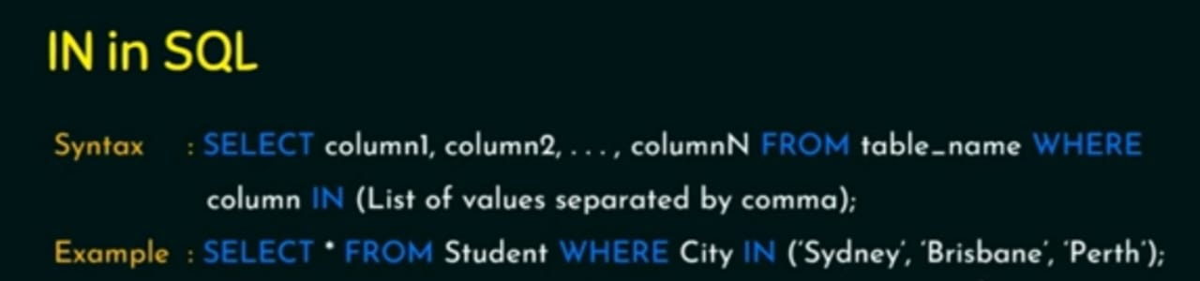

Slide 7
SQL allows queries that check whether an attribute value is NULL using the comparison operators IS or IS NOT.
Example: Retrieve the names of all employees who do not have supervisors.
SELECT Fname, Lname FROM EMPLOYEE WHERE Super_ssn IS NULL;
Explanation:
This query retrieves the first name (Fname) and last name (Lname) of employees from the EMPLOYEE table.
It filters the rows where the Super_ssn (which typically refers to the Social Security Number of an employee's supervisor) is NULL.
That means these employees do not have a supervisor — typically, this would be top-level managers or the head of the organization.

Slide 8
SELECT *FROM employees WHERE salary > 1200 AND department = 'Sales';
Explanation: NULL values in 'salary' or 'department' will result in an unknown value, and the row won't be selected
SELECT *FROM employees WHERE salary > 1200 OR department = 'Sales';
Explanation: NULL values in 'salary' or 'department' may still result in a row being selected if the other condition is true

Slide 9
IN Command
The IN command allows you to specify multiple values in a WHERE clause. The IN operator is a shorthand for multiple OR conditions.
The following SQL selects all customers that are located in "Germany", "France" and "UK":
SELECT * FROM Customers WHERE Country IN ('Germany', 'France', 'UK’);
The following SQL selects all customers that are NOT located in "Germany", "France" or "UK":
SELECT * FROM Customers WHERE Country NOT IN ('Germany', 'France', 'UK’);
The following SQL selects all customers that are from the same countries as the suppliers:
SELECT * FROM Customers WHERE Country IN (SELECT Country FROM Suppliers);

Slide 10
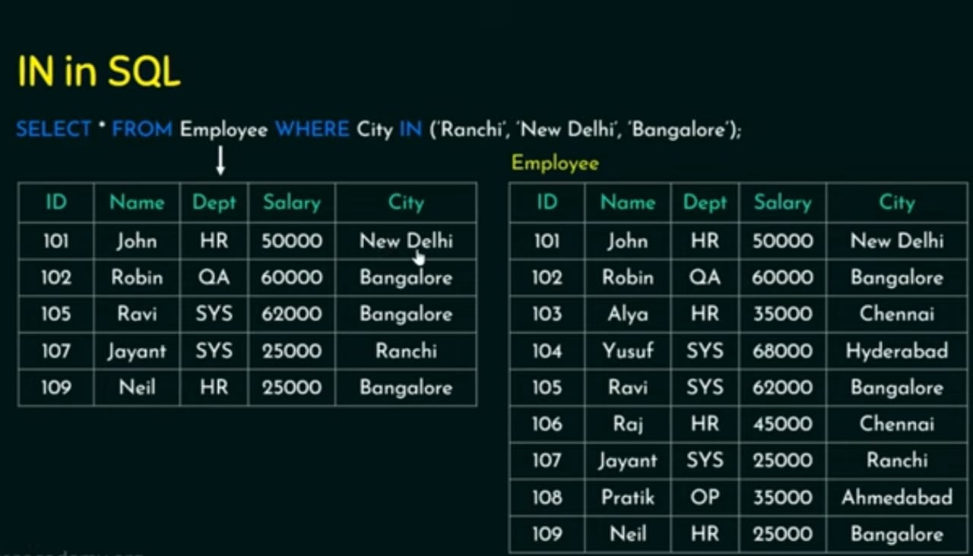

Slide 11
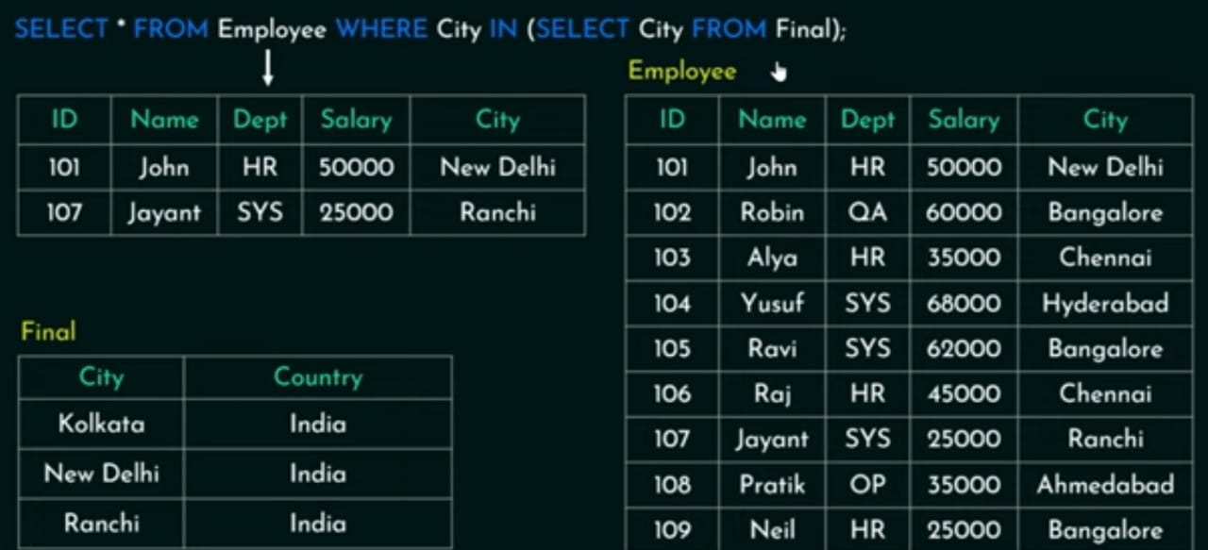

Slide 12
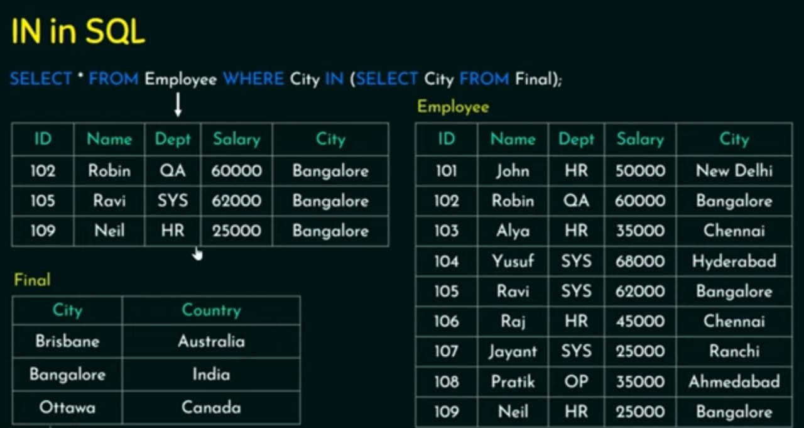

Slide 13
Nested Queries, Tuples, and Set/Multiset Comparisons
Some queries require that existing values in the database be fetched and then used in a comparison condition. Such queries can be conveniently formulated by using nested queries, which are complete select-from-where blocks within the WHERE clause of another query. That another query is called the outer query
List the project numbers of projects that have an employee with last name ‘Smith’ as manager
SELECT DISTINCT Pnumber FROM PROJECT WHERE
Pnumber IN
(SELECT Pnumber FROM PROJECT as P, DEPARTMENT as D, EMPLOYEE as E WHERE E.Dnum=D.Dnumber AND E.Mgr_ssn=E.Ssn AND E.Lname=‘smith’) ;

Slide 14
Inner Subquery:
SELECT Pnumber FROM PROJECT as P, DEPARTMENT as D, EMPLOYEE as E WHERE E.Dnum = D.Dnumber AND E.Mgr_ssn = E.Ssn AND E.Lname = 'smith'
This subquery uses implicit joins (comma-separated tables with conditions in the WHERE clause).
Tables involved:
PROJECT – contains project info (including Dnum, the department number the project is controlled by)
DEPARTMENT – contains department info (including Dnumber and Mgr_ssn, the SSN of the department manager)
EMPLOYEE – contains employee info (including Ssn and Lname)

Slide 15
Join conditions:
Dnum = Dnumber → connects a project to its controlling department.
Mgr_ssn = Ssn → connects the department to its manager.
Lname = 'smith' → filters to only those managers whose last name is Smith.
So, the subquery finds all Pnumber values of projects that are managed by a department with a manager named "Smith".
Outer Query:
SELECT DISTINCT Pnumber FROM PROJECT WHERE Pnumber IN ( ... ) ;
From the PROJECT table, return distinct project numbers that are in the result of the subquery above.
Using DISTINCT ensures no duplicates.

Slide 16
List the project numbers of projects that have an employee with the last name ‘Smith’ as either a manager or a worker.
SELECT DISTINCT Pnumber FROM PROJECT WHERE
Pnumber IN
(SELECT Pnumber FROM PROJECT, DEPARTMENT, EMPLOYEE WHERE Dnum=Dnumber AND Mgr_ssn=Ssn AND Pnumber IN
(SELECT Pno FROM WORKS_ON, EMPLOYEE WHERE Essn=Ssn AND Lname=‘smith’));

Slide 17
Condition 1:
The project is controlled by a department whose manager’s last name is 'Smith'.
Tables involved: PROJECT, DEPARTMENT, EMPLOYEE
Joins:
PROJECT.Dnum = DEPARTMENT.Dnumber
DEPARTMENT.Mgr_ssn = EMPLOYEE.Ssn
Filter:
EMPLOYEE.Lname = 'smith’
SELECT Pnumber FROM PROJECT, DEPARTMENT, EMPLOYEE WHERE Dnum = Dnumber AND Mgr_ssn = Ssn AND Lname = 'smith'
→ Returns all project numbers controlled by a department managed by someone named Smith.

Slide 18
Condition 2:
The project has at least one employee named 'Smith' working on it.
Tables involved: WORKS_ON, EMPLOYEE
Joins:
WORKS_ON.Essn = EMPLOYEE.Ssn
Filter:
EMPLOYEE.Lname = 'smith'
SELECT Pno FROM WORKS_ON, EMPLOYEE WHERE Essn = Ssn AND Lname = 'smith'
→ Returns all project numbers (Pno) that a 'Smith' works on.

Slide 19
Final Output:
The outer query:
SELECT DISTINCT Pnumber FROM PROJECT ...
→ Gets distinct project numbers from the PROJECT table where the project is either:
managed by a department manager named 'Smith' OR
has an employee named 'Smith' working on it.

Slide 20
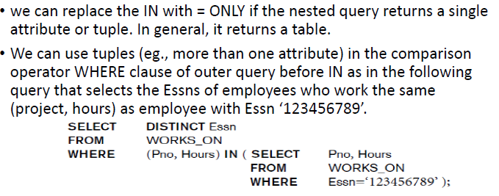

Slide 21
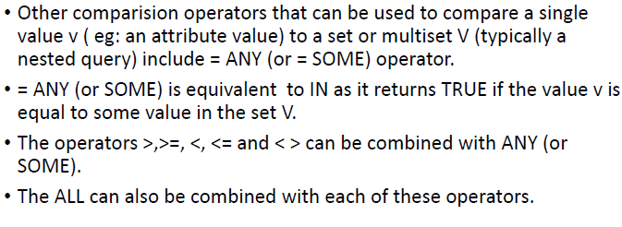
Nested Queries: Comparison Operators

Slide 22
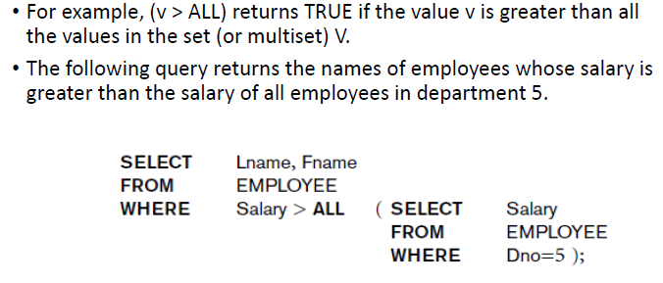
The ANY operator returns true if any subquery values meet the condition, and the ALL operator returns true if all subquery values meet the condition.

Slide 23
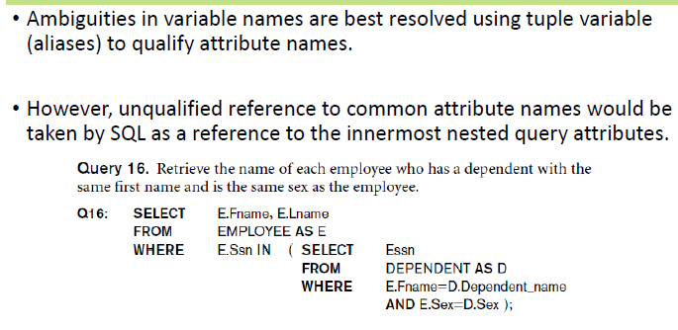

Slide 24
Correlated Nested Queries
Whenever a condition in the WHERE clause of a nested query references some attribute of a relation declared in the outer query, the two queries are said to be correlated.
SELECT E.Fname, E.Lname FROM EMPLOYEE AS E WHERE E.Ssn IN ( SELECT Essn FROM DEPENDENT AS D WHERE E.Fname=D.Dependent_name AND E.Sex=D.Sex );
The nested query is evaluated once for each tuple (or combination of tuples) in the outer query. We can think of query in above example as follows:
For each EMPLOYEE tuple, evaluate the nested query, which retrieves the Essn values for all DEPENDENT tuples with the same sex and name as that EMPLOYEE tuple; if the Ssn value of the EMPLOYEE tuple is in the result of the nested query, then select that EMPLOYEE tuple.

Slide 25
Nested and correlated queries are both types of subqueries in SQL, where a query is embedded within another. Nested queries are independent and run once, while correlated queries are dependent on the outer query and run for each row of the outer query.
Nested Queries:
The inner query runs independently of the outer query, meaning it is executed only once to produce a result.
The result of the nested query is then used by the outer query, typically as part of a WHERE clause condition.
SELECT * FROM employees WHERE salary > (SELECT AVG(salary) FROM employees)
Here, the inner query calculates the average salary once and is then used by the outer query to select employees with salaries above the average.

Slide 26
Correlated Queries
The inner query is executed for each row processed by the outer query.
The inner query's result depends on the specific values in the current row of the outer query.
Correlated queries essentially implement a looping mechanism within the SQL query, evaluating the inner query multiple times.
SELECT * FROM employees WHERE EXISTS (SELECT 1 FROM departments WHERE employees.department_id = departments.id);
For each employee, the inner query checks if there is a corresponding department, effectively filtering the employees based on their department.

Slide 27
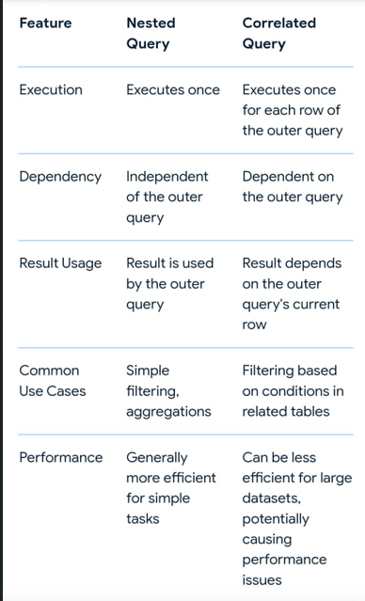

Slide 28
The EXISTS and UNIQUE Functions in SQL
EXISTS Functions
The EXISTS function in SQL is used to check whether the result of a correlated nested query is empty (contains no tuples) or not. The result of EXISTS is a Boolean value
TRUE if the nested query result contains at least one tuple, or FALSE if the nested query result contains no tuples.

Slide 29
Retrieve the name of each employee who has a dependent with the same first name and is the same sex as the employee can be written using EXISTS functions as follows:
SELECT E.Fname, E.Lname FROM EMPLOYEE AS E WHERE EXISTS ( SELECT * FROM DEPENDENT AS D WHERE E.Ssn=D.Essn AND E.Sex=D.Sex AND E.Fname=D.Dependent_name);

Slide 30
List the names of managers who have at least one dependent
SELECT Fname, Lname FROM EMPLOYEE WHERE EXISTS ( SELECT * FROM DEPENDENT WHERE Ssn=Essn ) AND EXISTS ( SELECT * FROM DEPARTMENT WHERE Ssn=Mgr_ssn );
In general, EXISTS(Q) returns TRUE if there is at least one tuple in the result of the nested query Q, and it returns FALSE otherwise.

Slide 31
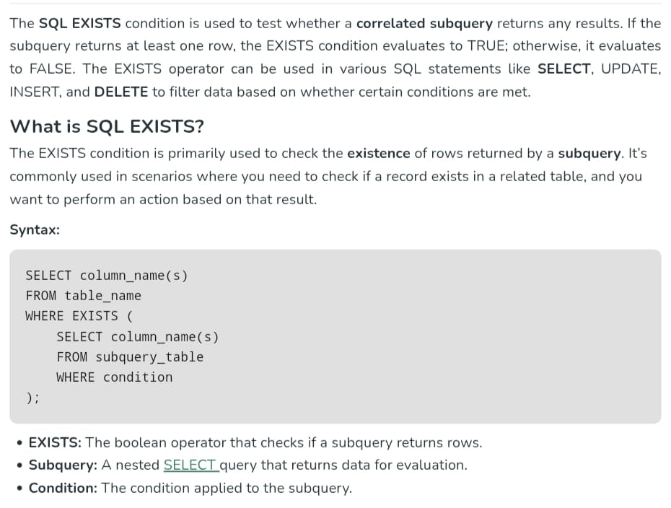

Slide 32
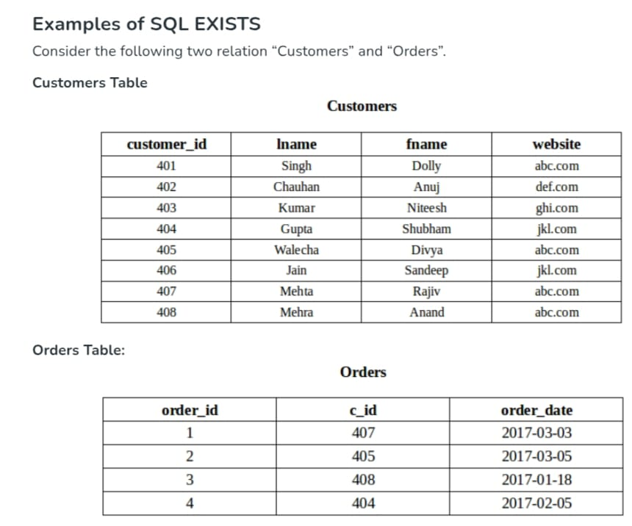

Slide 33
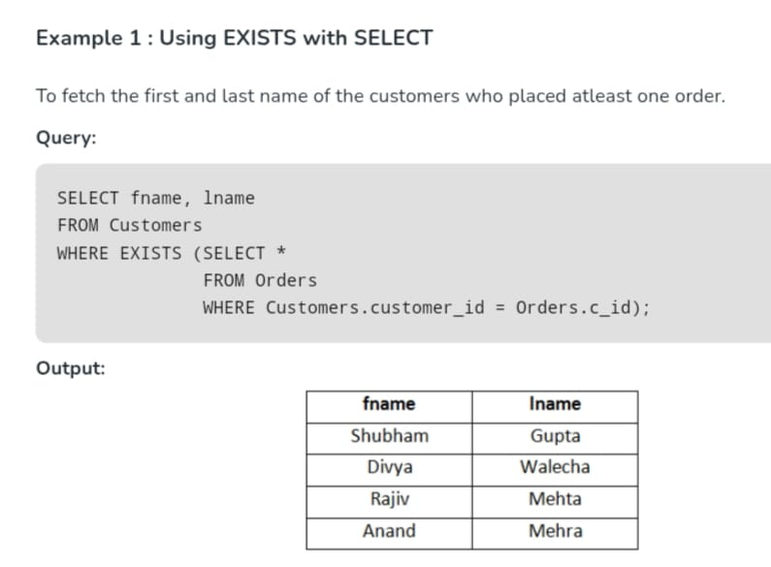

Slide 34
NOT EXISTS Functions
NOT EXISTS(Q) returns TRUE if there are no tuples in the result of nested query Q, and it returns FALSE otherwise.
Retrieve the names of employees who have no dependents.
SELECT Fname, Lname FROM EMPLOYEE WHERE NOT EXISTS ( SELECT * FROM DEPENDENT WHERE Ssn=Essn );
For each EMPLOYEE tuple, the correlated nested query selects all DEPENDENT tuples whose Essn value matches the EMPLOYEE Ssn; if the result is empty, no dependents are related to the employee, so we select that EMPLOYEE tuple and retrieve its Fname and Lname.

Slide 35
Retrieve the name of each employee who works on all the projects controlled by department number 5
SELECT Fname, Lname FROM EMPLOYEE WHERE NOT EXISTS ( ( SELECT Pnumber FROM PROJECT WHERE Dnum=5) EXCEPT ( SELECT Pno FROM WORKS_ON WHERE Ssn=Essn) );

Slide 36
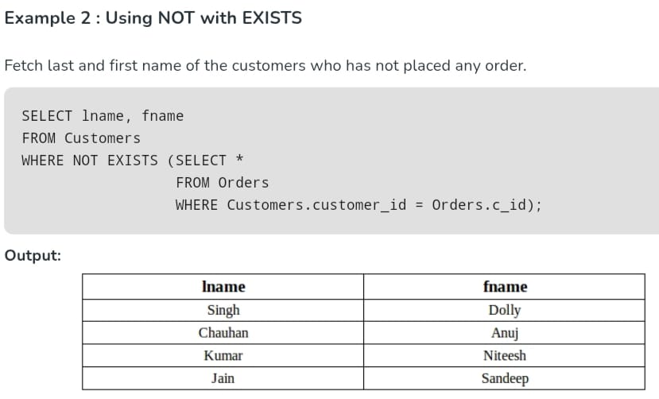

Slide 37
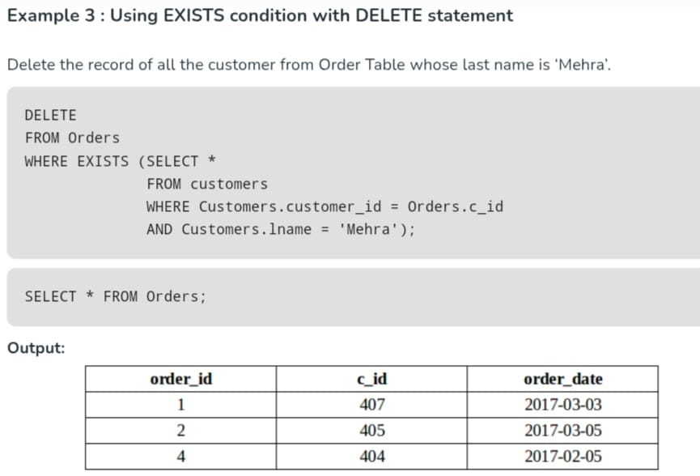

Slide 38
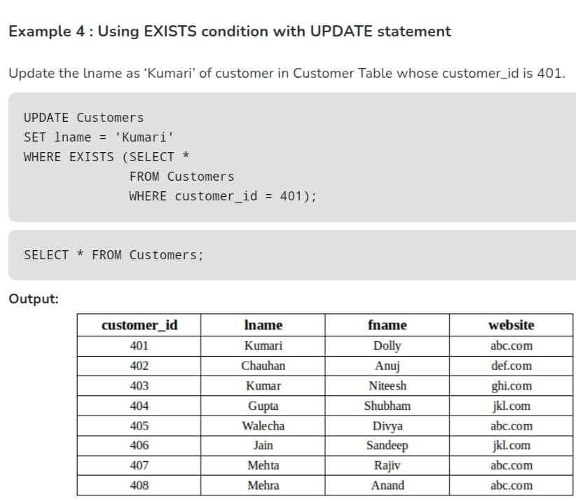

Slide 39
UNIQUE Functions
UNIQUE(Q) returns TRUE if there are no duplicate tuples in the result of query Q; otherwise, it returns FALSE. This can be used to test whether the result of a nested query is a set or a multiset.
CREATE TABLE Users ( user_id INT PRIMARY KEY, email VARCHAR(100) UNIQUE, username VARCHAR(50) UNIQUE);
email and username must be unique across all rows.

Slide 40
Explicit Sets and Renaming of Attributes in SQL
IN SQL it is possible to use an explicit set of values in the WHERE clause, rather than a nested query. Such a set is enclosed in parentheses.
Retrieve the last name of each employee and his or her supervisor
SELECT E.Lname AS Employee_name, S.Lname AS Supervisor_name FROM EMPLOYEE AS E, EMPLOYEE AS S WHERE E.Super_ssn=S.Ssn;

Slide 41
Joined Tables in SQL and Outer Joins
An SQL JOIN clause is used to query and access data from multiple tables by establishing logical relationships between them.
It can access data from multiple tables simultaneously using common key values shared across different tables. We can use SQL JOIN with multiple tables.
It can also be paired with other clauses, the most popular use will be using JOIN with WHERE clause to filter data retrieval.

Slide 42
INNER JOIN: Returns only the rows where there is a match in both tables.
LEFT JOIN (LEFT OUTER JOIN): Returns all rows from the left table, and the matched rows from the right table. If there’s no match, NULL values are returned for columns from the right table.
RIGHT JOIN (RIGHT OUTER JOIN): Returns all rows from the right table, and the matched rows from the left table. If there’s no match, NULL values are returned for columns from the left table.
FULL JOIN (FULL OUTER JOIN): Returns all rows when there is a match in one of the tables. If there’s no match, NULL values are returned for columns from the table without a match

Slide 43
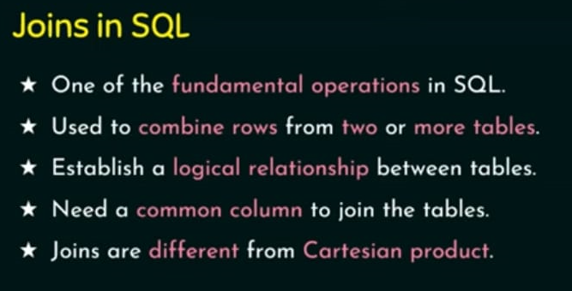


Slide 44
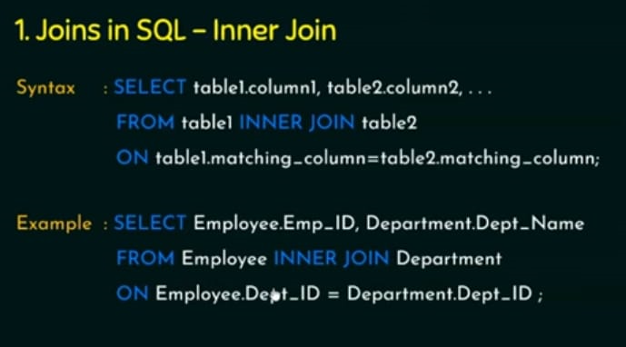

Slide 45
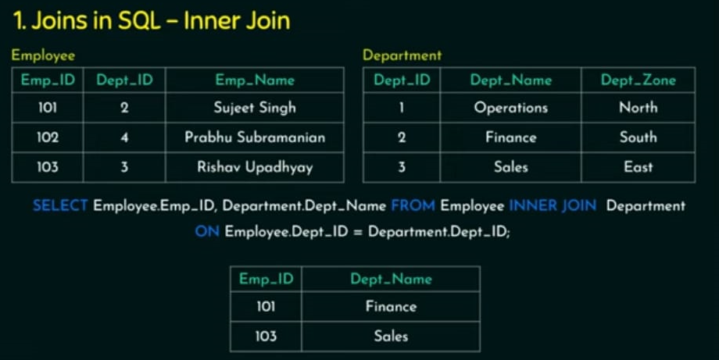

Slide 46
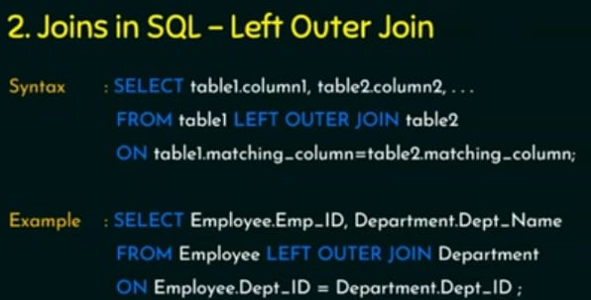

Slide 47
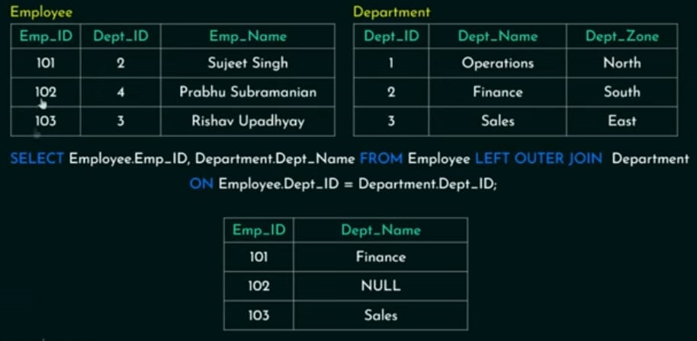

Slide 48
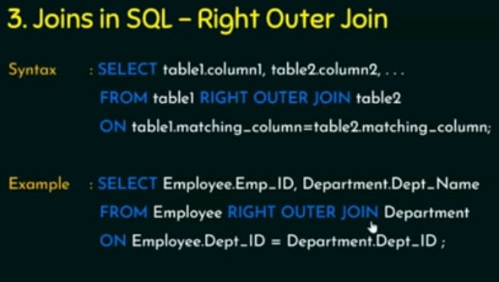

Slide 49
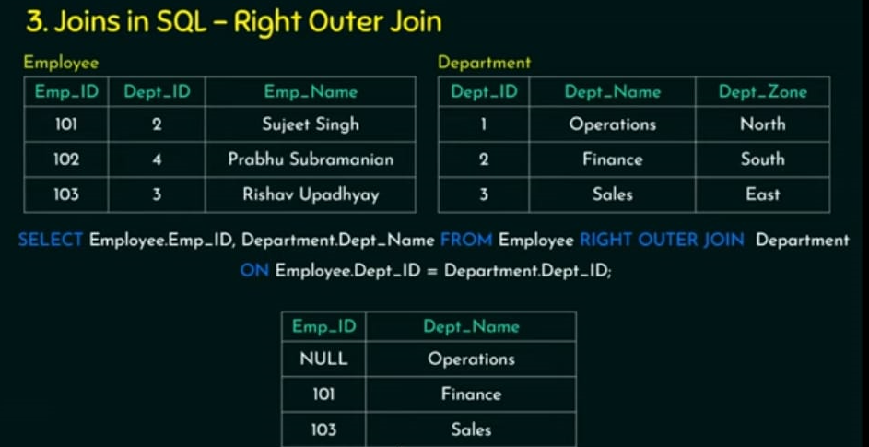

Slide 50


Slide 51
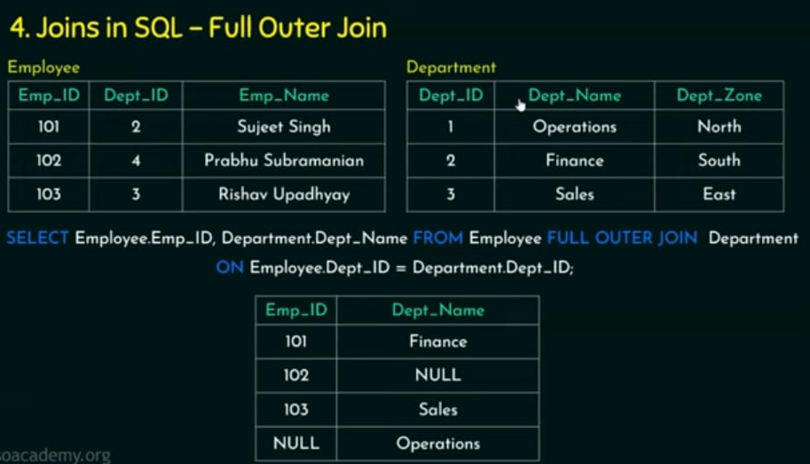

Slide 52
Natural Join
Natural join equivalent to inner join.
In inner join the condition will be explicitly mention .
If join condition is not mention explicitly and database software is going to find the matching column and do the join operation then it is called as natural join.
In inner join condition will be explicitly mention using the keyword on whereas in natural join .
We wont specify the condition explicitly and system will implicitly take a join condition and perform the operation
(But both the table should have on similar data type)
Natural join by default uses = comparison operation

Slide 53
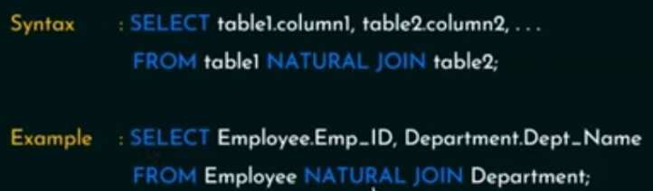

Slide 54
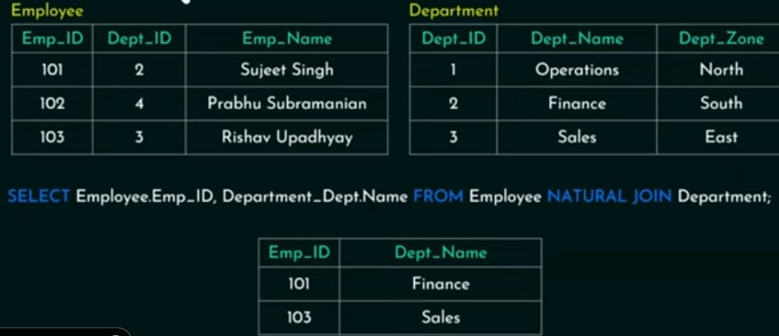

Slide 55
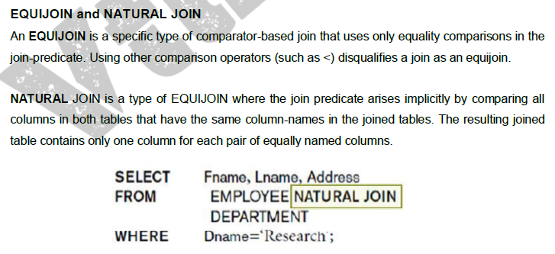

Slide 56
In SQL, if you write just JOIN without specifying the type (like INNER, LEFT, RIGHT, etc.), defaults to an INNER JOIN.
SELECT * FROM table1 JOIN table2 ON table1.id = table2.id;
is the same as
SELECT * FROM table1 INNER JOIN table2 ON table1.id = table2.id;
INNER JOIN only returns rows where there is a match in both tables based on the join condition. If there's no match, that row is not included in the result.

Slide 57
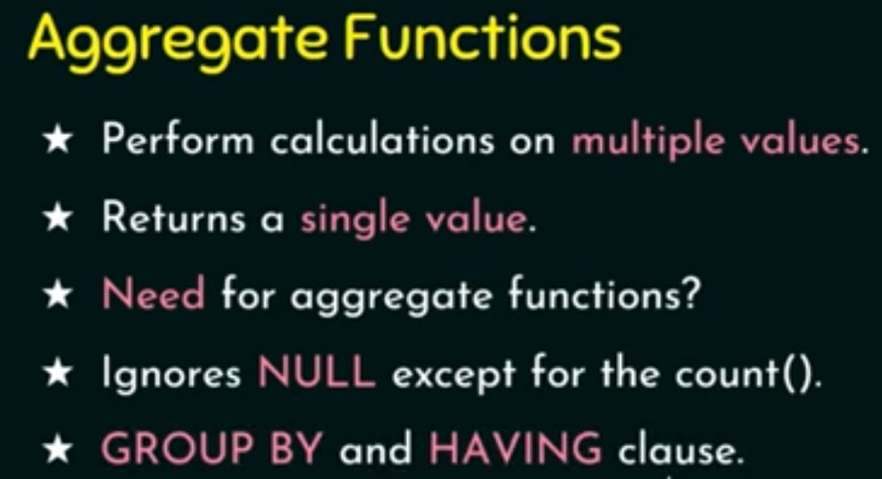

Slide 58
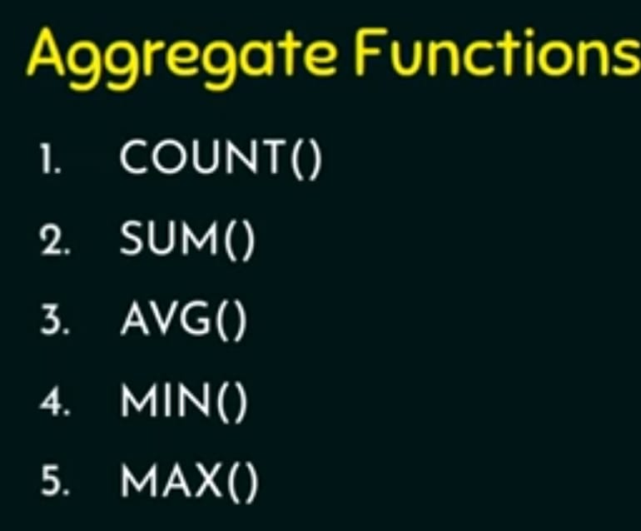

Slide 59
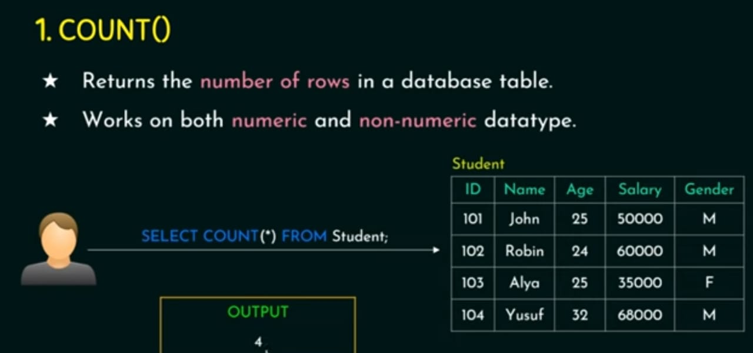

Slide 60
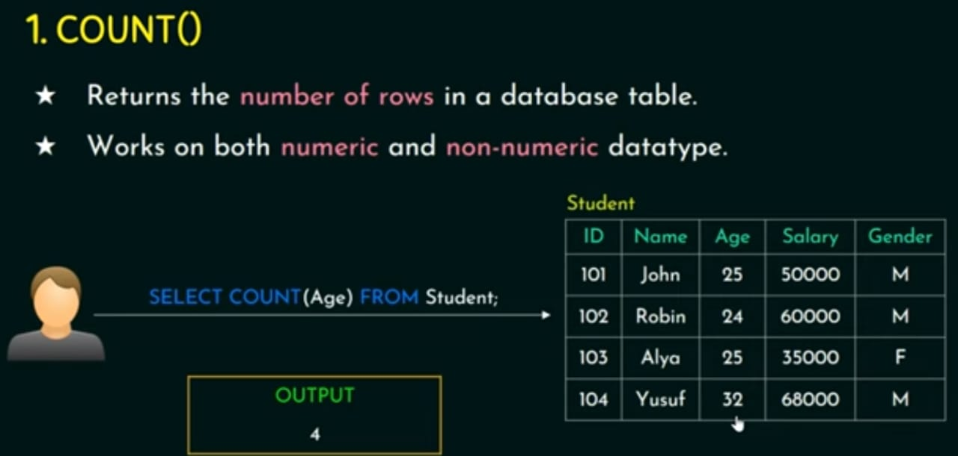

Slide 61
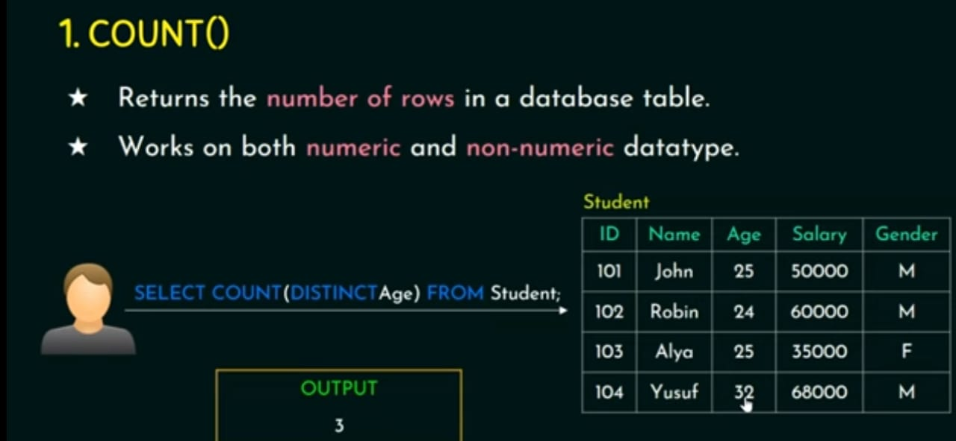

Slide 62
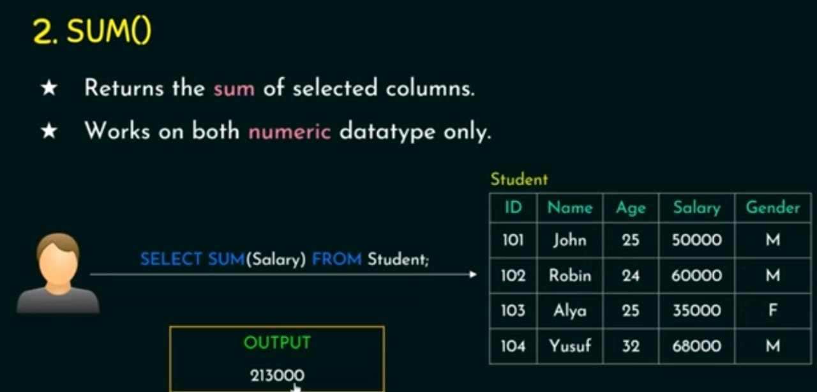

Slide 63
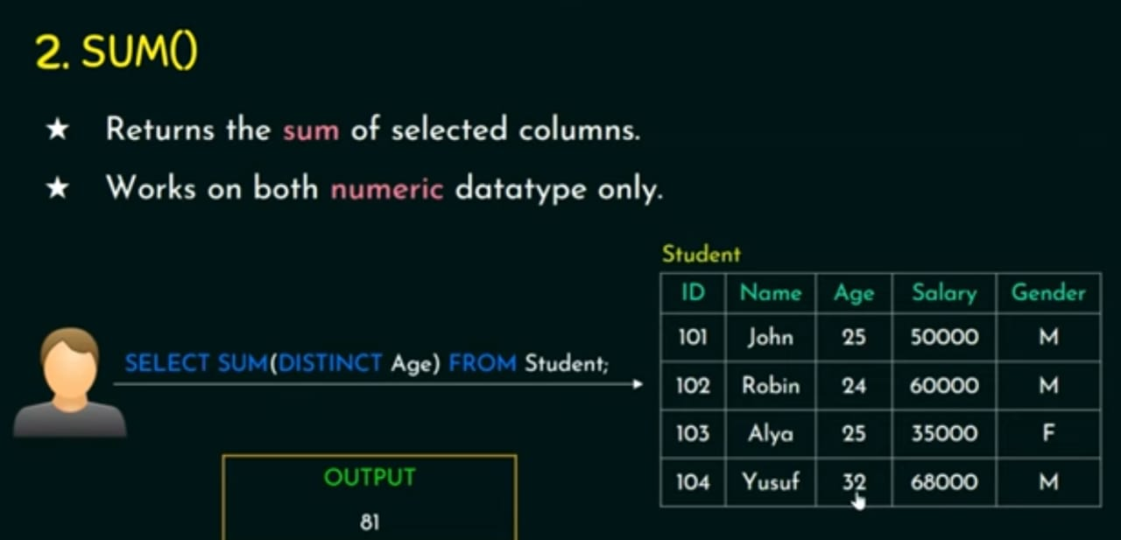

Slide 64
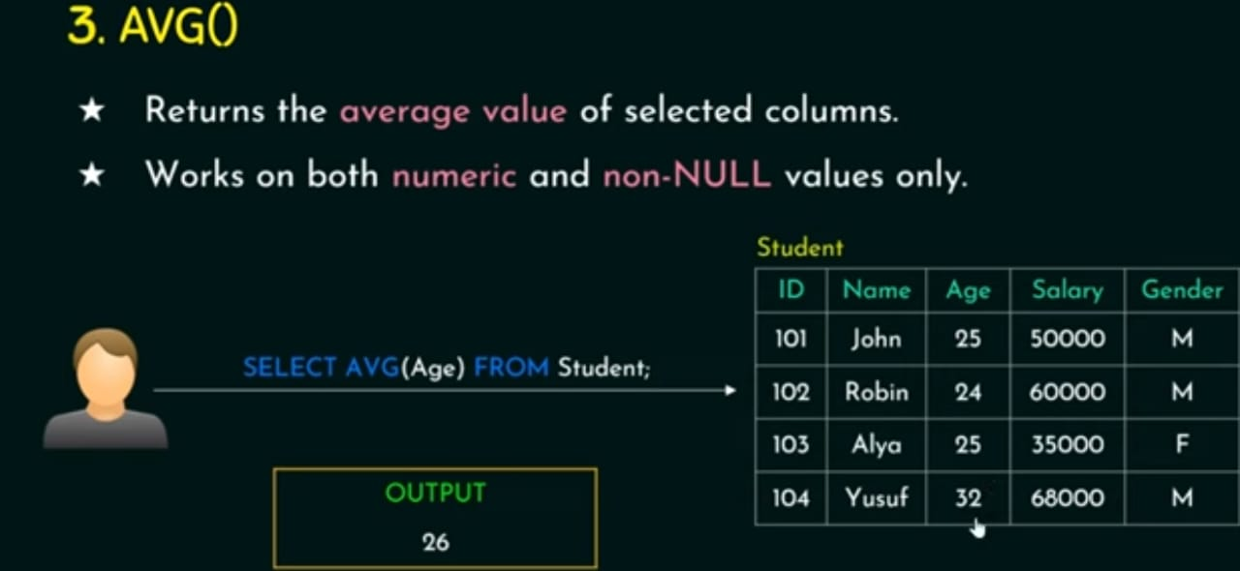

Slide 65
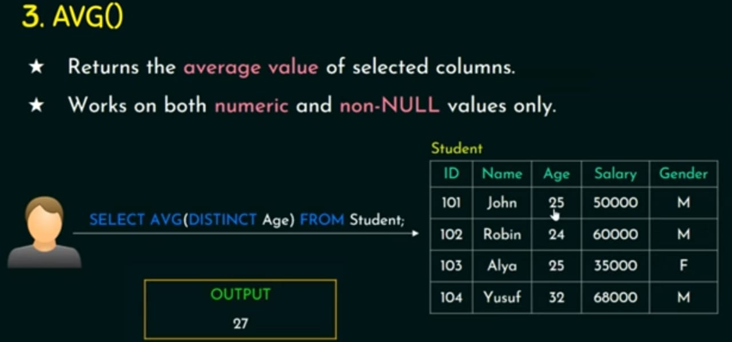

Slide 66
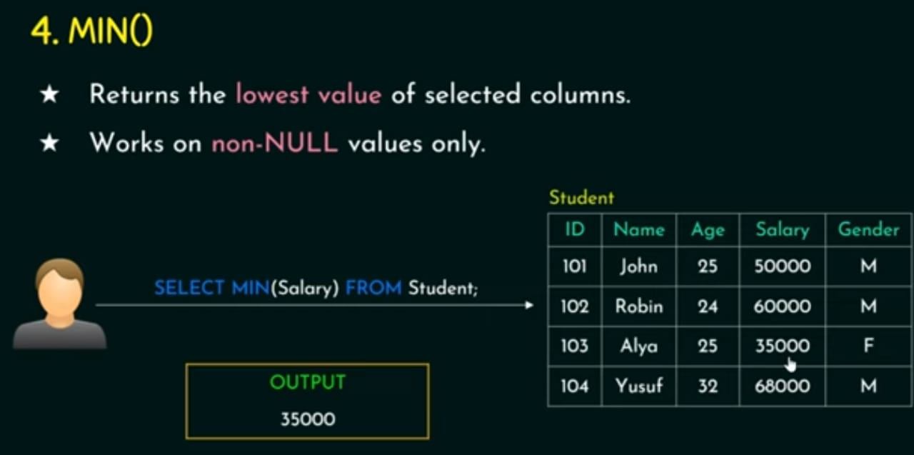

Slide 67
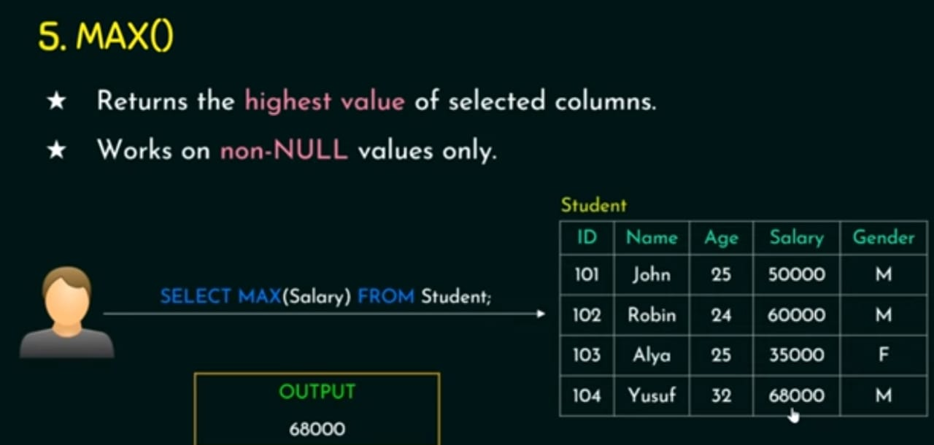

Slide 68
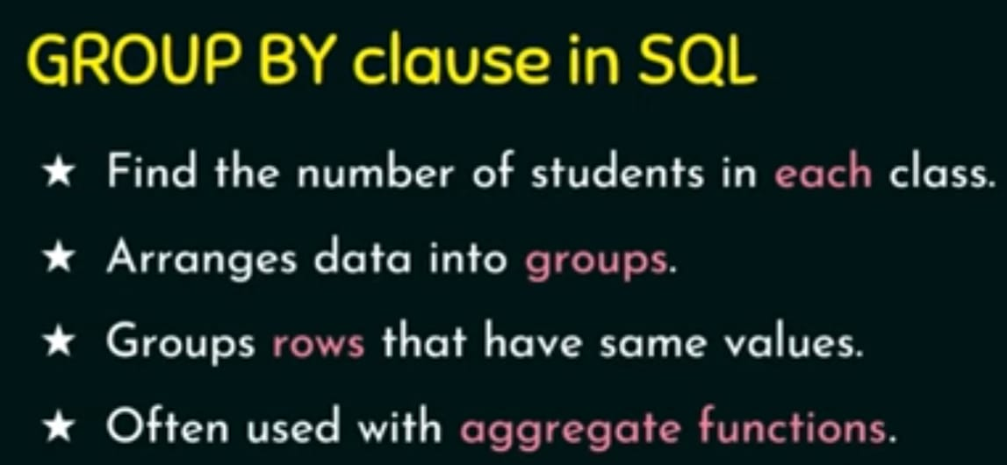

Slide 69
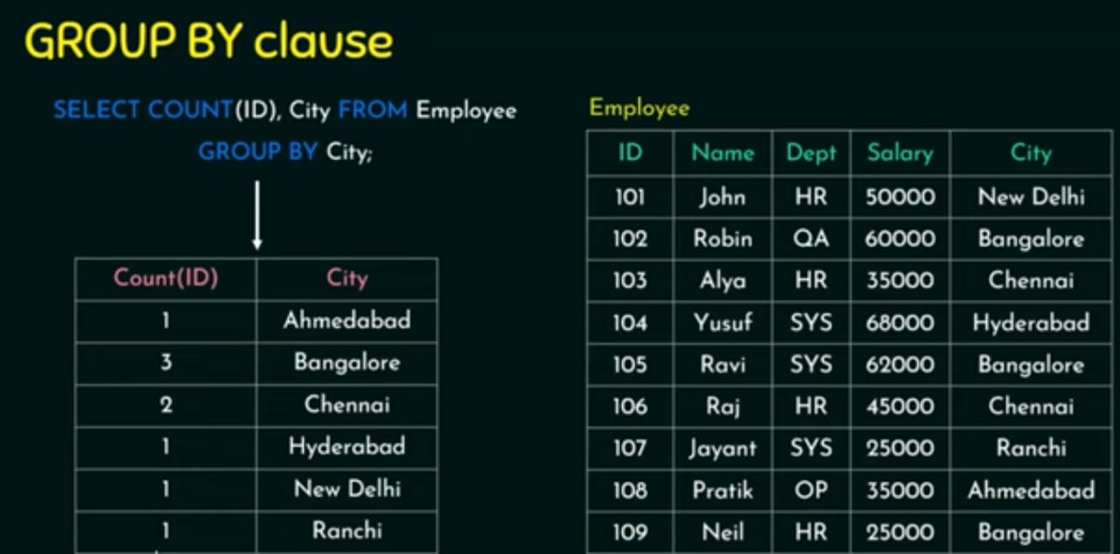

Slide 70

The GROUP BY clause combines similar rows, producing a single result row for each group of rows that have the same values, for each column listed in the Projection clause. The HAVING clause sets conditions on those groups after you form them.

Slide 71
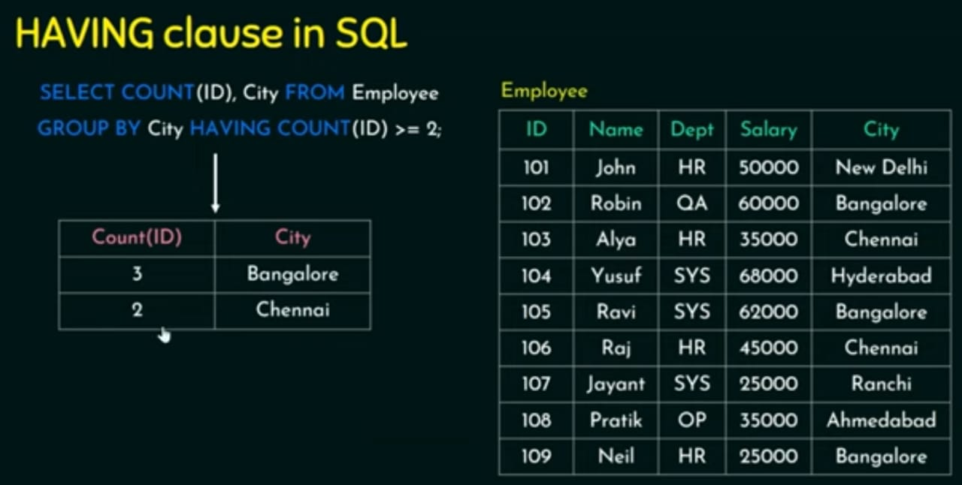

Slide 72
Assertions
Assertions are used to specify integrity constraints which can not be specified using constraints like PRIMARY KEY, NOT NULL, UNIQUE , DEFAUT , CHECK etc.
Assertions is an expression that should be always true.
DBMS enforces the assertion on the database and the constraints specified in assertion must not be violated.
DBMS always checks the assertion whenever modifications are done in corresponding table.

Slide 73
Syntax to create an assertion
CREATE ASSERTION<assertion name> CHECK (<condition>);
DBMS tests the assertion for its validity when it is created.
Example: The price of textbook must not be less then the minimum price of a novel.
CREATE ASSERTION price_constraint CHECK(NOT EXISTS(SELECT * FROM BOOK WHERE category = ‘textbook’ AND(price > (SELECT min(price) FROM BOOK WHERE category=‘Novel’))));
NOT EXISTS indicates that the result of this query must be empty
Assertion is violated whenever the result of query inside NOT EXISTS clause is not empty.

Slide 74
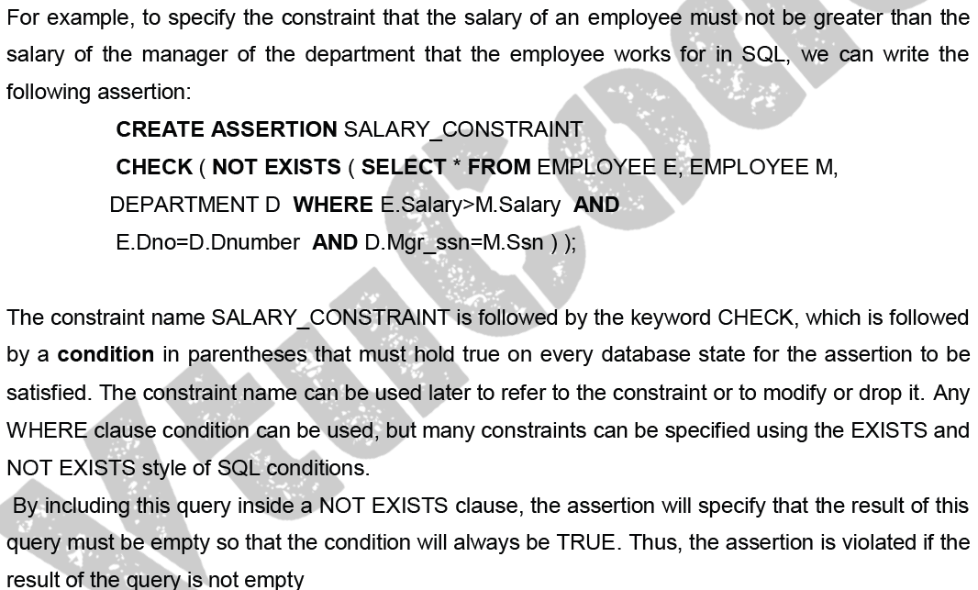

Slide 75
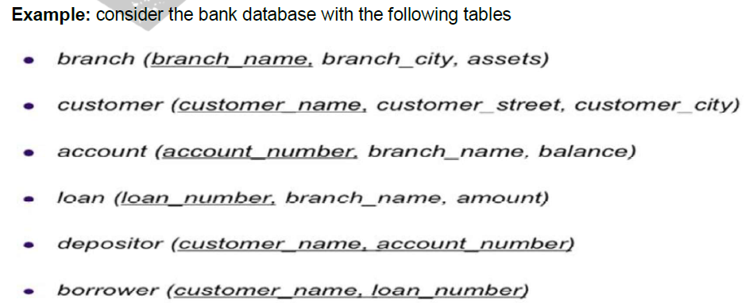

Slide 76
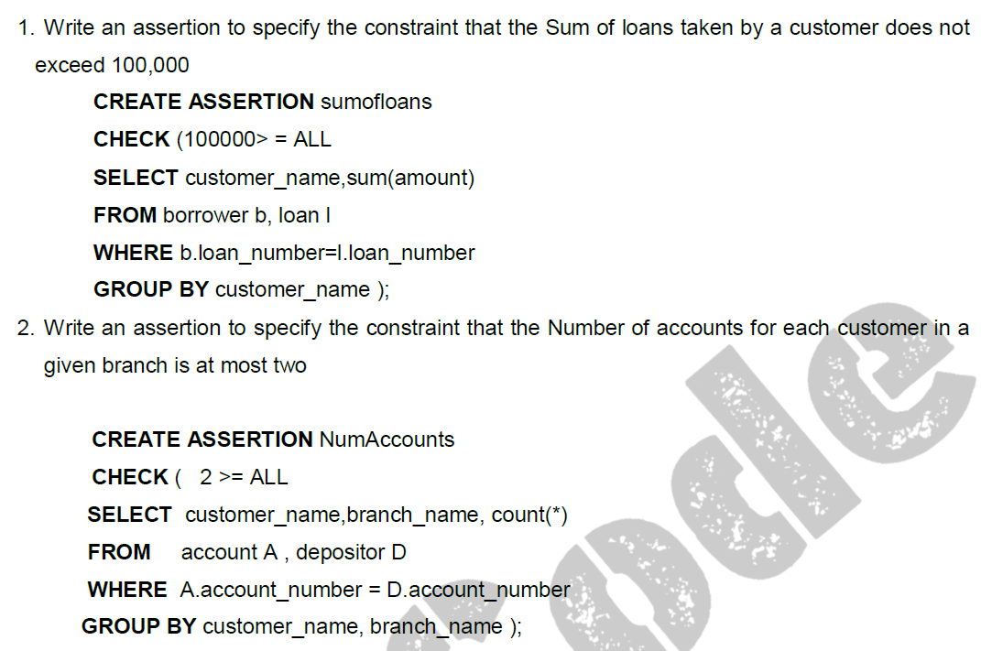

Slide 77
Introduction to Triggers in SQL
A trigger is a procedure that runs automatically when a certain event occurs in the DBMS.
In many cases it is convenient to specify the type of action to be taken when certain events occur and when certain conditions are satisfied. The CREATE TRIGGER statement is used to implement such actions in SQL.
General form:
CREATE TRIGGER <name>
BEFORE | AFTER | <events>
FOR EACH ROW |FOR EACH STATEMENT
WHEN (<condition>)
<action>

Slide 78
A trigger has three components
1. Event: When this event happens, the trigger is activated
Three event types: Insert, Update, Delete
Two triggering times: Before the event
After the event
2. Condition (optional): If the condition is true, the trigger executes; otherwise skipped
3. Action: The actions performed by the trigger
When the Event occurs and the Condition is true, execute the Action

Slide 79
Views
It is a Virtual table constructed from existing table with required attributes.
Existing table can be single or multiple table.
Changes made in table reflects on view.
Changes made in view reflects in table.

Slide 80
Syntax
CREATE VIEW view_name AS
SELECT col_name 1,col_name 2,………FROM TABLE 1
WHERE CONDITION;
CREATE VIEW view_name AS
SELECT col_name 1,col_name 2,……….FROM table 1, table 2
WHERE table 1.col_name = table 2.col_name ;

Slide 81
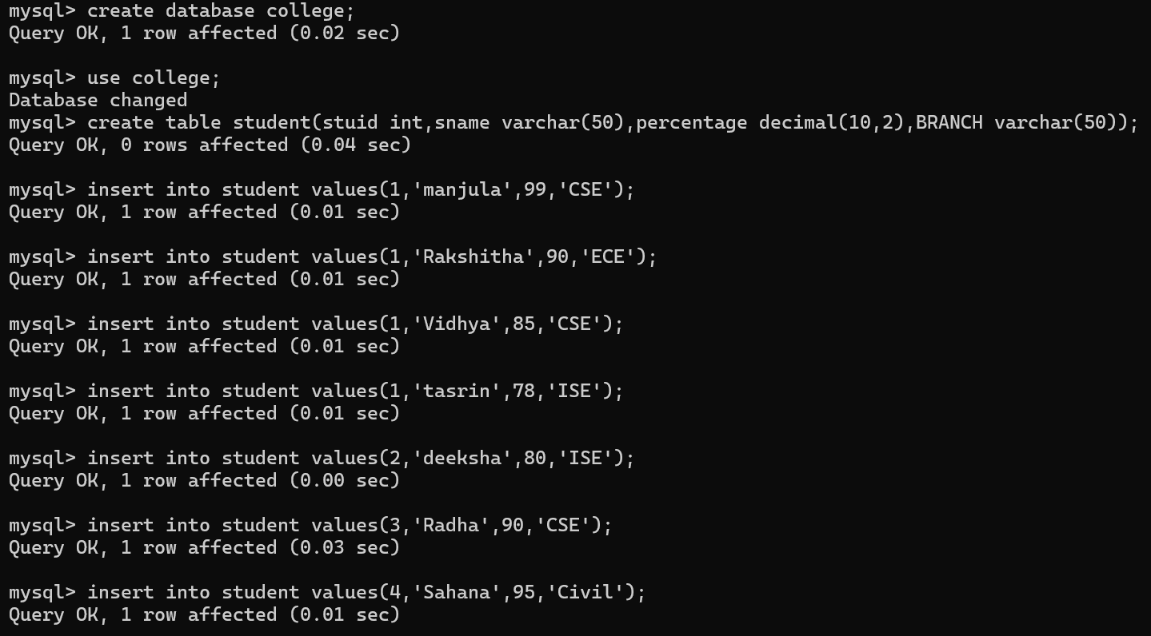

Slide 82
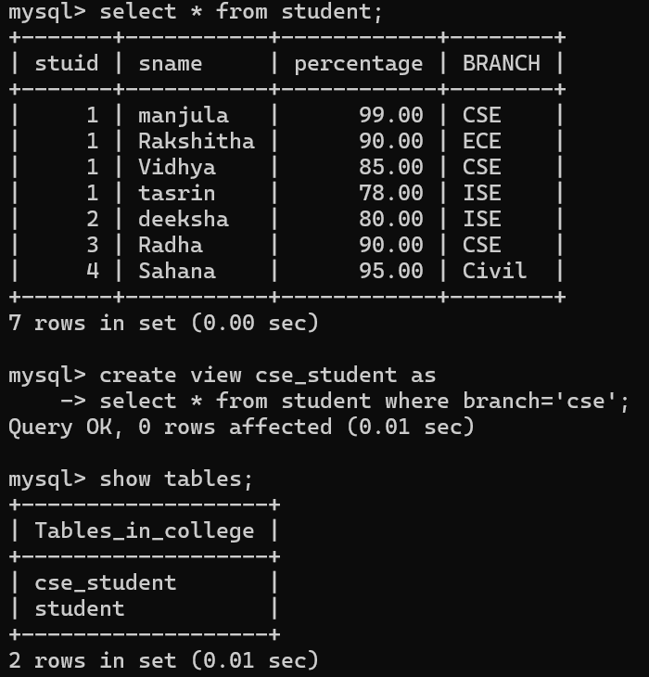
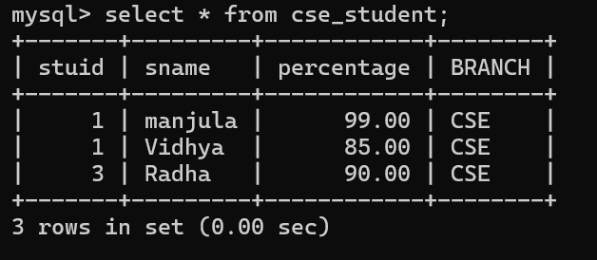

Slide 83
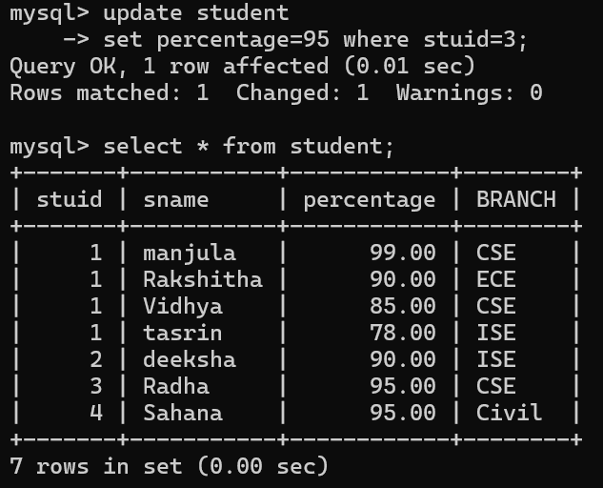

Slide 84


Slide 85


Slide 86


Slide 87


Slide 88


Slide 89


Slide 90



Slide 91


Slide 92
Schema Change statements in SQLs
The DROP Command
Drop command is used to delete the table from database as well as to delete complete database.
Example:
Create database company;
Create table employee(empid int, ename varchar(50), address varchar(50));
Drop table employee;
Drop database company;

Slide 93
The ALTER Command
The ALTER TABLE statement is used to add, delete, or modify columns in an existing table.
The ALTER TABLE statement is also used to add and drop various constraints on an existing table.

Slide 94
ALTER TABLE - ADD Column
To add a column in a table, use the following syntax:
ALTER TABLE table_name ADD column_name datatype;
The following SQL adds an "Email" column to the "Customers" table:
ALTER TABLE Customers ADD Email varchar(255);

Slide 95
ALTER TABLE - RENAME COLUMN ;
To rename a column in a table, use the following syntax:
ALTER TABLE table_name RENAME COLUMN old_name to new_name;
ALTER TABLE - ALTER/MODIFY DATATYPE
To change the data type of a column in a table, use the following syntax:
ALTER TABLE table_name MODIFY column_name datatype;

Slide 96
Reference Notes link: https://github.com/TahirAcharya/dbms

